Slide 1
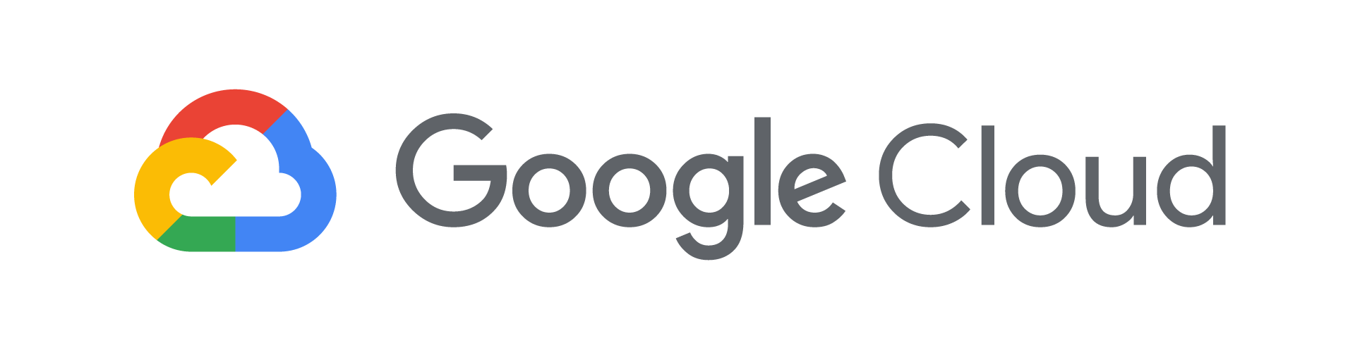
Production ML Pipelines with Kubeflow

Slide 2

Agenda
Ways to do ML on GCP
Kubeflow
AI Hub

Slide 3







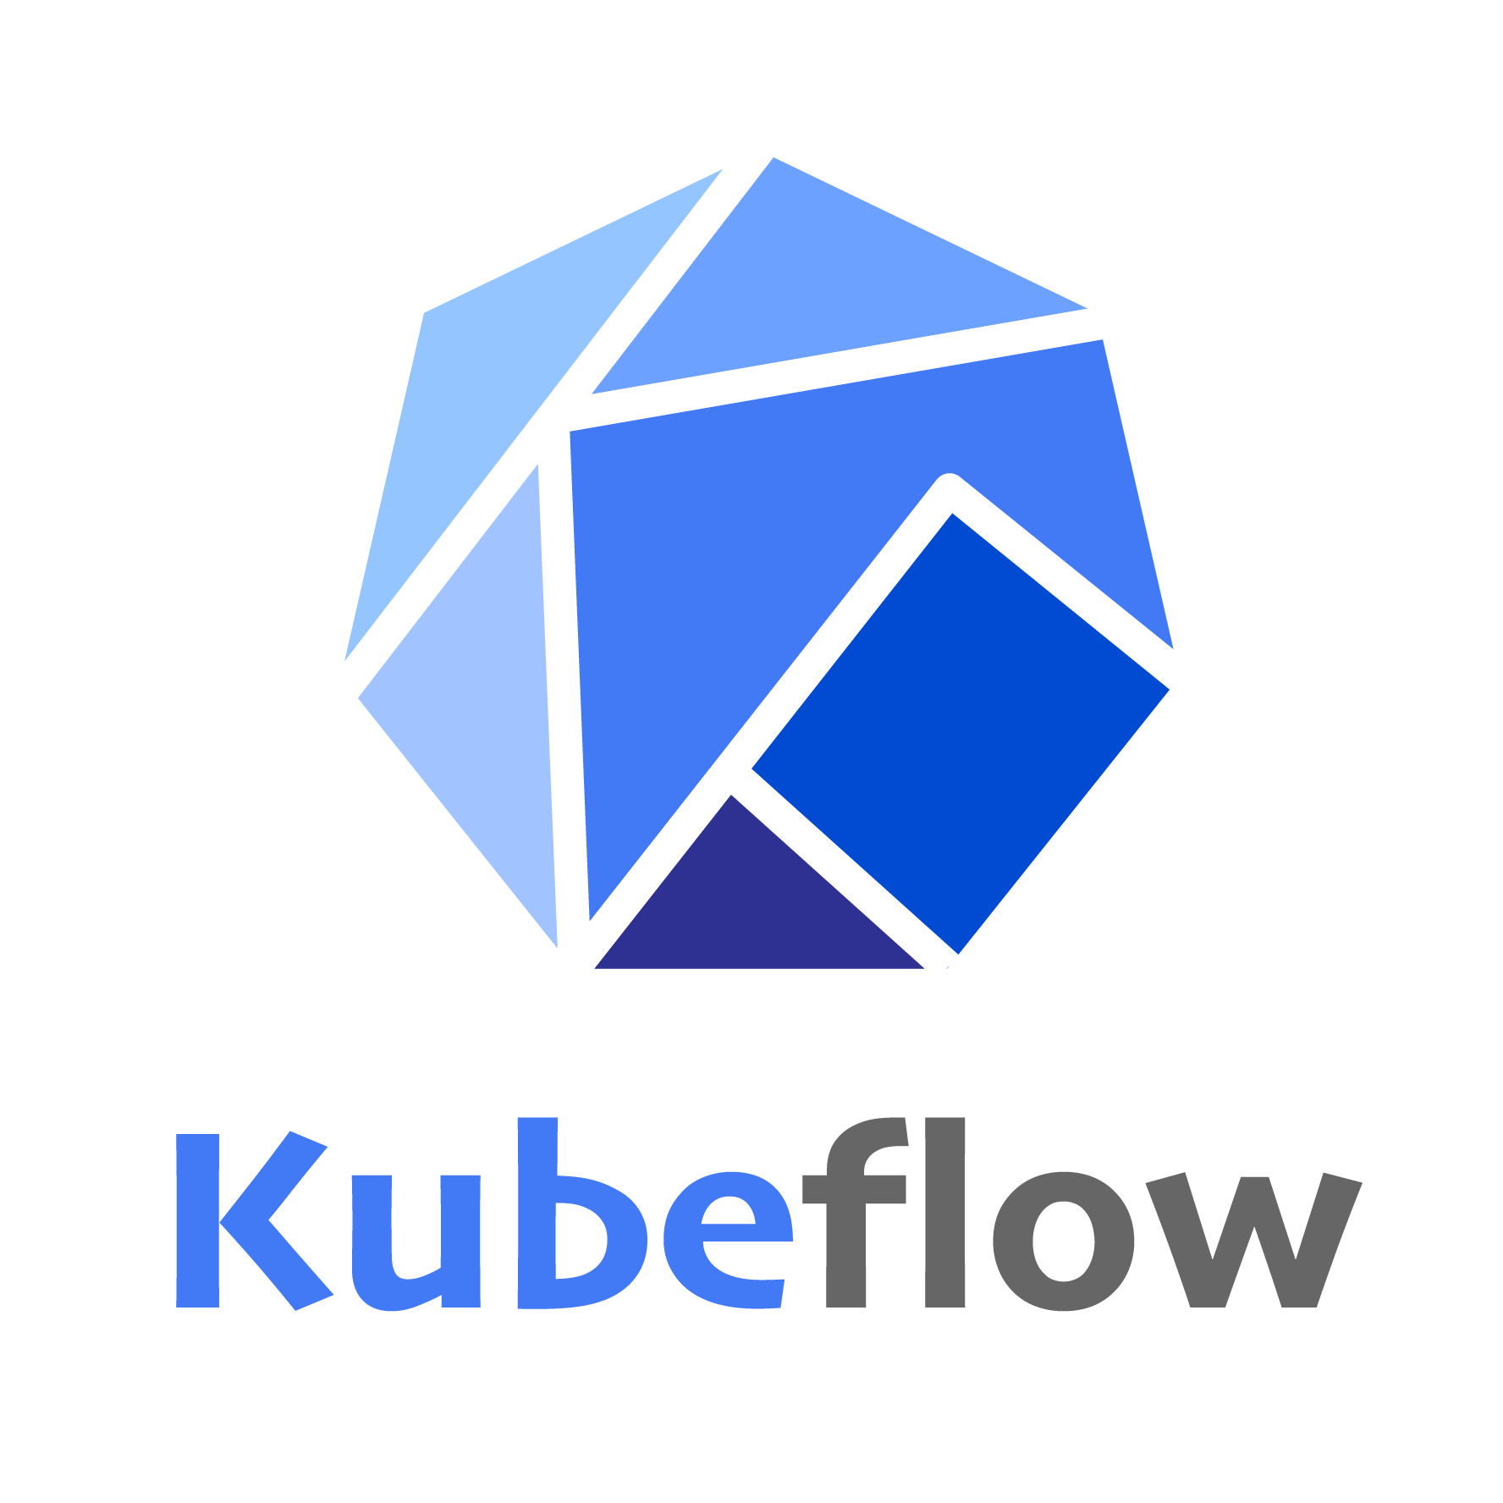

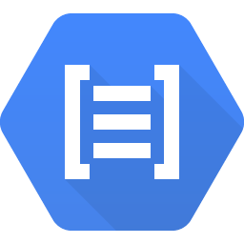
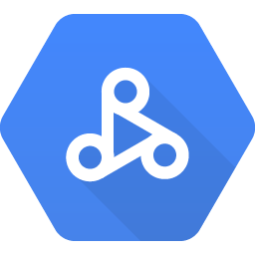
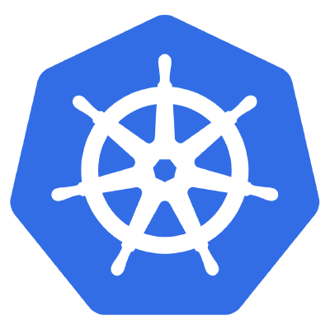

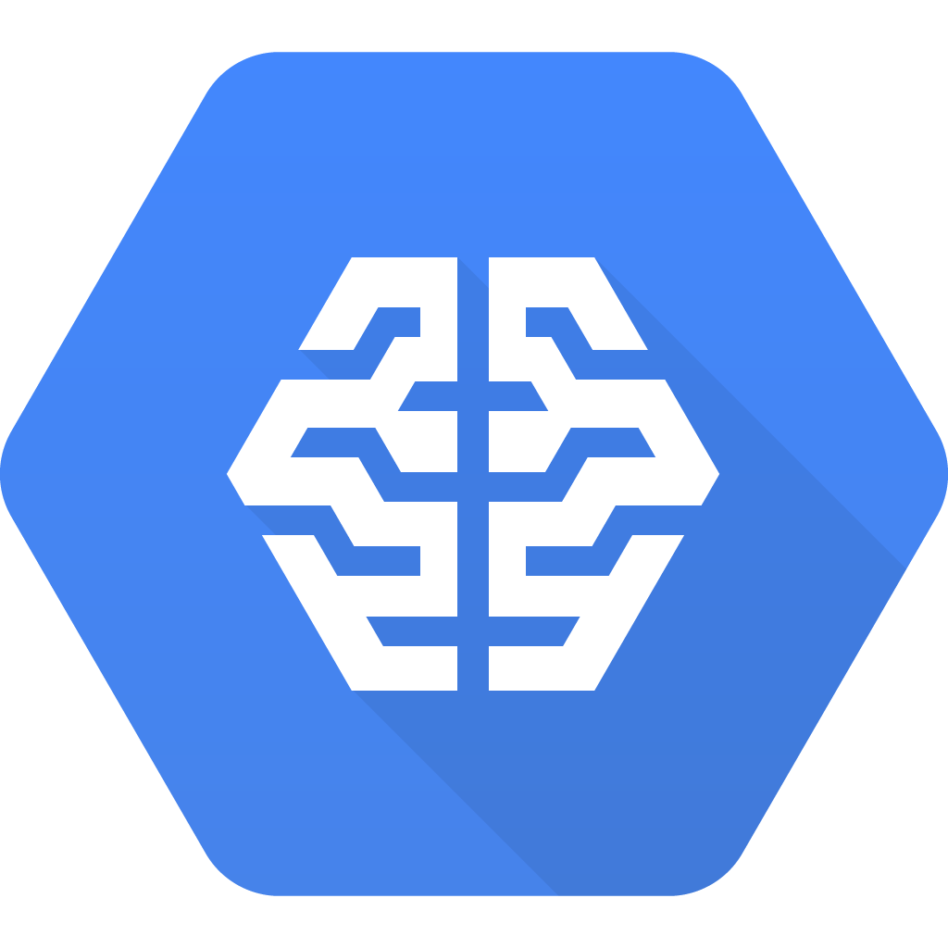

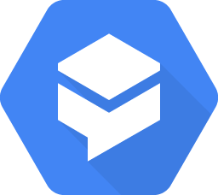
Create and deploy custom models with Kubeflow
Build a Custom Model
Build Custom Model (codeless)
Call a Pretrained Model
AutoML
Cloud TPUs
Compute Engine
Cloud Translation API
Cloud Vision API
Cloud Speech API
Cloud Video
Intelligence API
Data Loss Prevention API
Cloud Speech Synthesis API
Cloud Natural Language API
Cloud Dataproc
Kubernetes Engine
Cloud AI Platform
BigQuery ML
Dialogflow

Slide 4

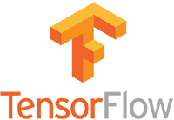

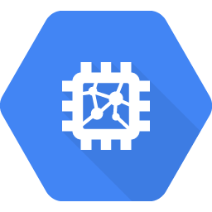


Cloud AI Platform is a fully managed service for custom machine learning models
AI Platform
Cloud TPU
Scales to production
Batching and distribution of model training
Performs transformations on input data
Hyper-parameter tuning
Host and autoscale predictions
Serverless - self-tuning - manages overhead

Slide 5
In this course, we don’t cover writing TensorFlow models, only ways to operationalize them
Intro to ML on GCP Specialization on Coursera

Slide 6
Agenda
Ways to do ML on GCP
Kubeflow
AI Hub

Slide 7
Perception: ML products are mostly about ML
Data Verification
Machine Resource Management
Data Collection
ML Code
Serving Infrastructure
Configuration
Monitoring
Feature Extraction
Process Management Tools
Analysis Tools

Slide 8
Reality: ML Requires lots of DevOps
Serving Infrastructure
Data Verification
Machine Resource Management
Monitoring
Configuration
Data Collection
ML Code
Analysis Tools
Feature Extraction
Process Management Tools
Source: Sculley et al.: Hidden Technical Debt in Machine Learning Systems
Notes:
ML systems are large, complicated distributed systems.
We started building Kubeflow to tackle these devops challenges using Kubernetes and containers

Slide 9
Kubeflow provides a platform for building ML products
Leverage containers and Kubernetes to solve the challenges of building ML products
Kubeflow = Cloud Native, multi-cloud solution for ML.
Kubeflow provides a platform for composable, portable and scalable ML pipelines
If you have a Kubernetes conformant cluster, you can run Kubeflow

Slide 10
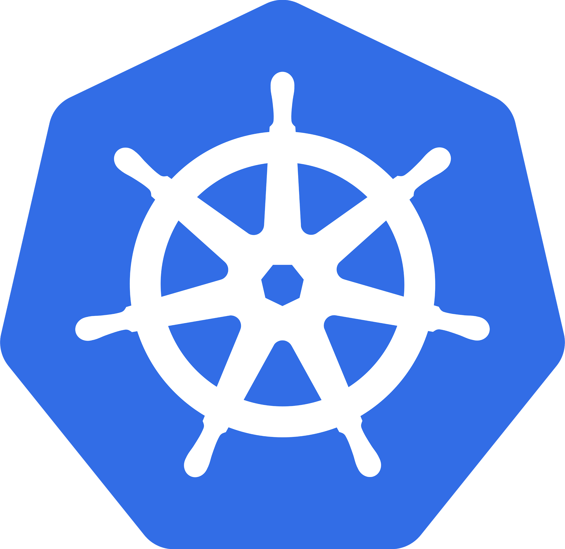
Kubernetes is a great platform for ML
Containers
Scaling built in
Unified architecture
Easy to integrate building blocks
ML APIs
Dataflow
Lots of options for CI/CD
Portability
Dev, On-Prem, Multi-cloud: same stack
Notes:
Before we dive into the specifics of Kubeflow Pipelines, I should provide additional context.
Kubeflow Pipelines is a part of the open source project Kubeflow.
Kubeflow is a platform that provides the tools and scalable services required to develop and deploy ML workloads, all the way from distributed training, to scalable serving, to Notebooks w/ JupyterHub and workflow orchestration and much more.
Kubeflow services are built on top on Kubernetes. Kubernetes provides scalability and hybrid protability. You can run Kubeflow anywhere you can run a Kubernetes cluster, and thus applications built on Kubeflow are portable across clouds and on-premise environmetns. On GCP, You can easily deploy Kubeflow on Google Kubernetes Engine.

Slide 11



Kubeflow Pipelines enable:
ML Workflow Orchestration
Share, Re-use & Compose
Rapid Reliable Experimentation
Notes:
Ok now lets dive into Kubeflow Pipelines.
The capabilities provided by Kubeflow pipelines can largely be put into three buckets:

Slide 12
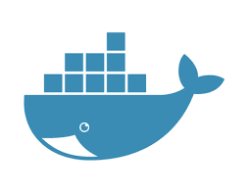
What constitutes a Kubeflow Pipeline
Containerized implementations of ML Tasks
Containers provide portability, repeatability and encapsulation
A task can be single node or *distributed*
A containerized task can invoke other services like CMLE, Dataflow or Dataproc
Specification of the sequence of steps
Specified via Python SDK
Input Parameters
A “Job” = Pipeline invoked w/ specific parameters
Notes:
Let me provide a peek under the hood:

Slide 13
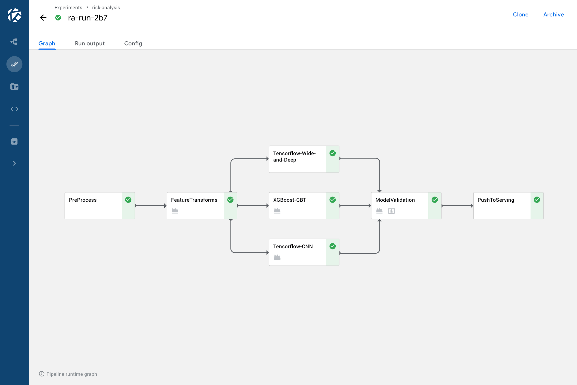
Visual depiction of pipeline topology
Training models in parallel
Data pre-processing & validation
Label 3
Deploy for serving
Label 1
Label 4
Label 2
Score on test set & pick best model
Feature engineering
Notes:
To make things more concrete lets look at a screenshot of an illustrative workflow that was run on Kubeflow Pipelines.
This is just an illustrative workflow and users can author and run many different kinds of workflow topologies with different code&tools in the various steps of the workflow
For each workflow that is run on Kubeflow PIpelines, you get a rich visual depticton of the topology so that you know what was executed as part of the workflow
In this workflow we start with a data preprocessign and validation step
Followed by feature engineeirng
Following by a fork where we traing many different kinds of models
The models that are trained are then analyzed and compared on a test data set
Finally, if an improved model is produced, it is deployed to a serving endpoint

Slide 14
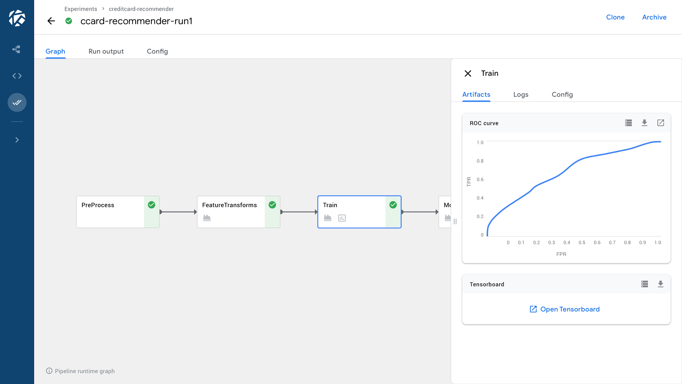
Rich visualization of metrics
Label 3
Label 1
Label 2
Notes:
For each step of the workflow, you have rich ML specific infornation at your finger tips.
Just click on a step and visualize relevant metrics produced by that step, such as an ROC curve for example.
If you did model training and produced the rich metadata that can be visualized with TensorBoard, that is just a click away.

Slide 15
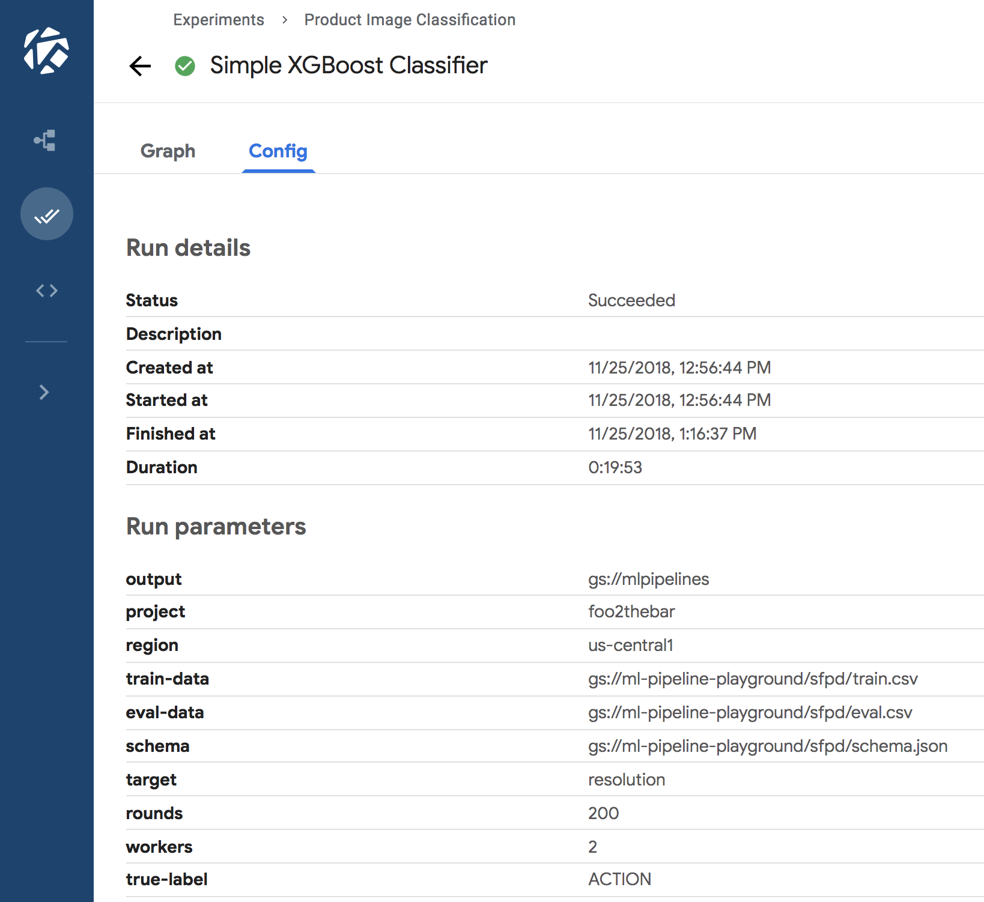
View all configs, inputs and outputs
Notes:
For each step of the workflow you can see the precise configuration parameters, and inputs and outputs.
Thus, for a model trained with Kubeflow PIpelines, you never have to wonder, how exactly did I create this model

Slide 16
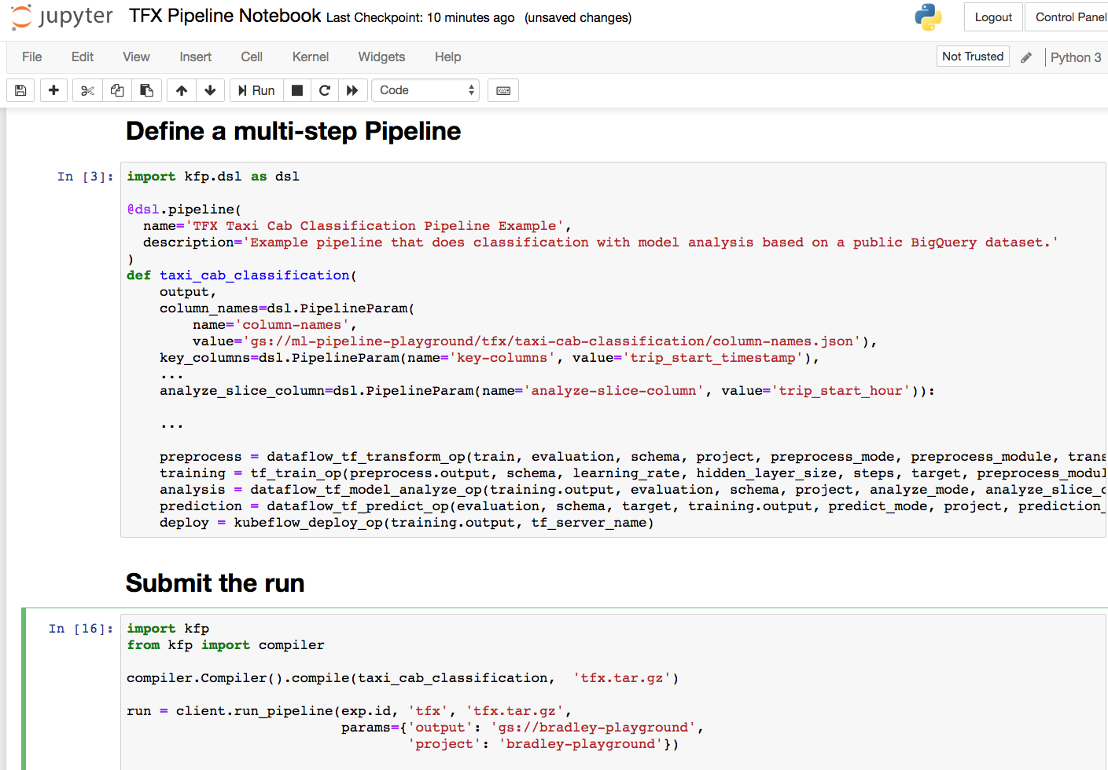
Author pipelines with an intuitive Python SDK
Notes:
Lingua franca of ML practitioners
Python SDK to define the workflow i.e. define every step of teh workflow, the inputs and output, and also define how the various steps are connected. The topology of the workflow is implicitly defined by connecting the various steps i.e. connecting the outputs of an upstream step to the inputs of a downstream step.
You can also define looping constrtucts as well as conditional steps.

Slide 17
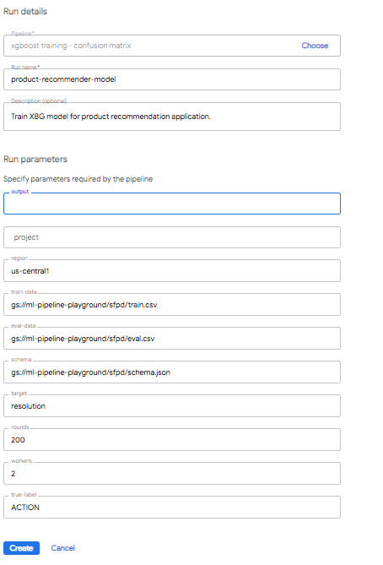
Package & share pipelines
as zip files
Upload and execute pipelines via UI (in addition to API/SDK)
Pipeline steps can be authored as reusable components

Slide 18
Rapid, Reliable, Experimentation
Clone
Edit
Every run logged with all config params, inputs, outputs & metrics
Easily search and find old runs
Clone and re-run or modify
Rapidly iterate on ideas
Submit

Slide 19
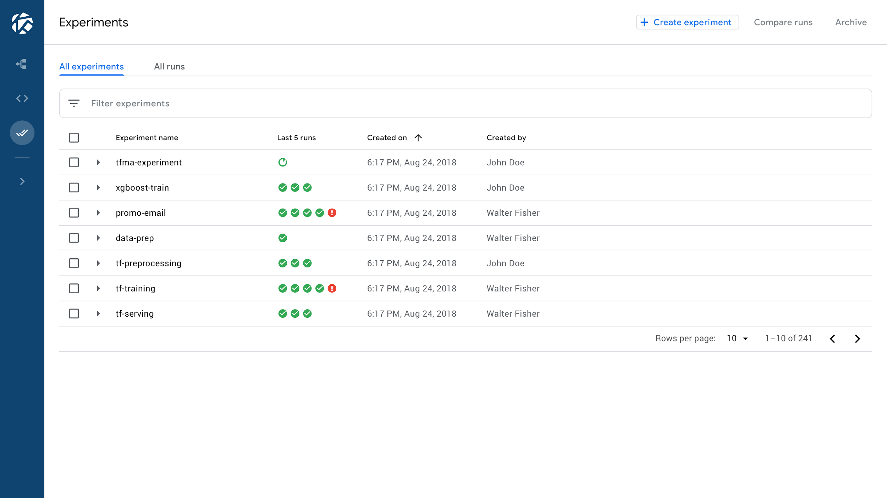
View all current
and past runs in
one place
Label 3
Label 1
Label 2

Slide 20
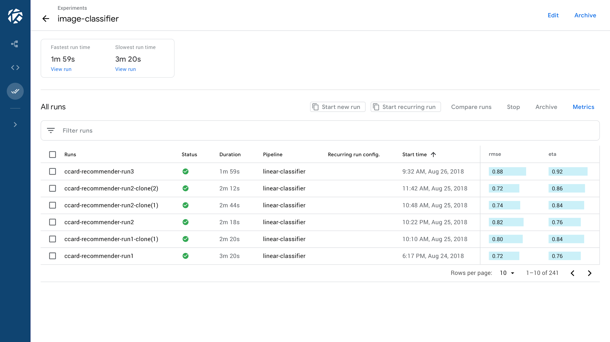
Easy comparison
and analysis
of runs
Label 3
Label 1
Label 2

Slide 21
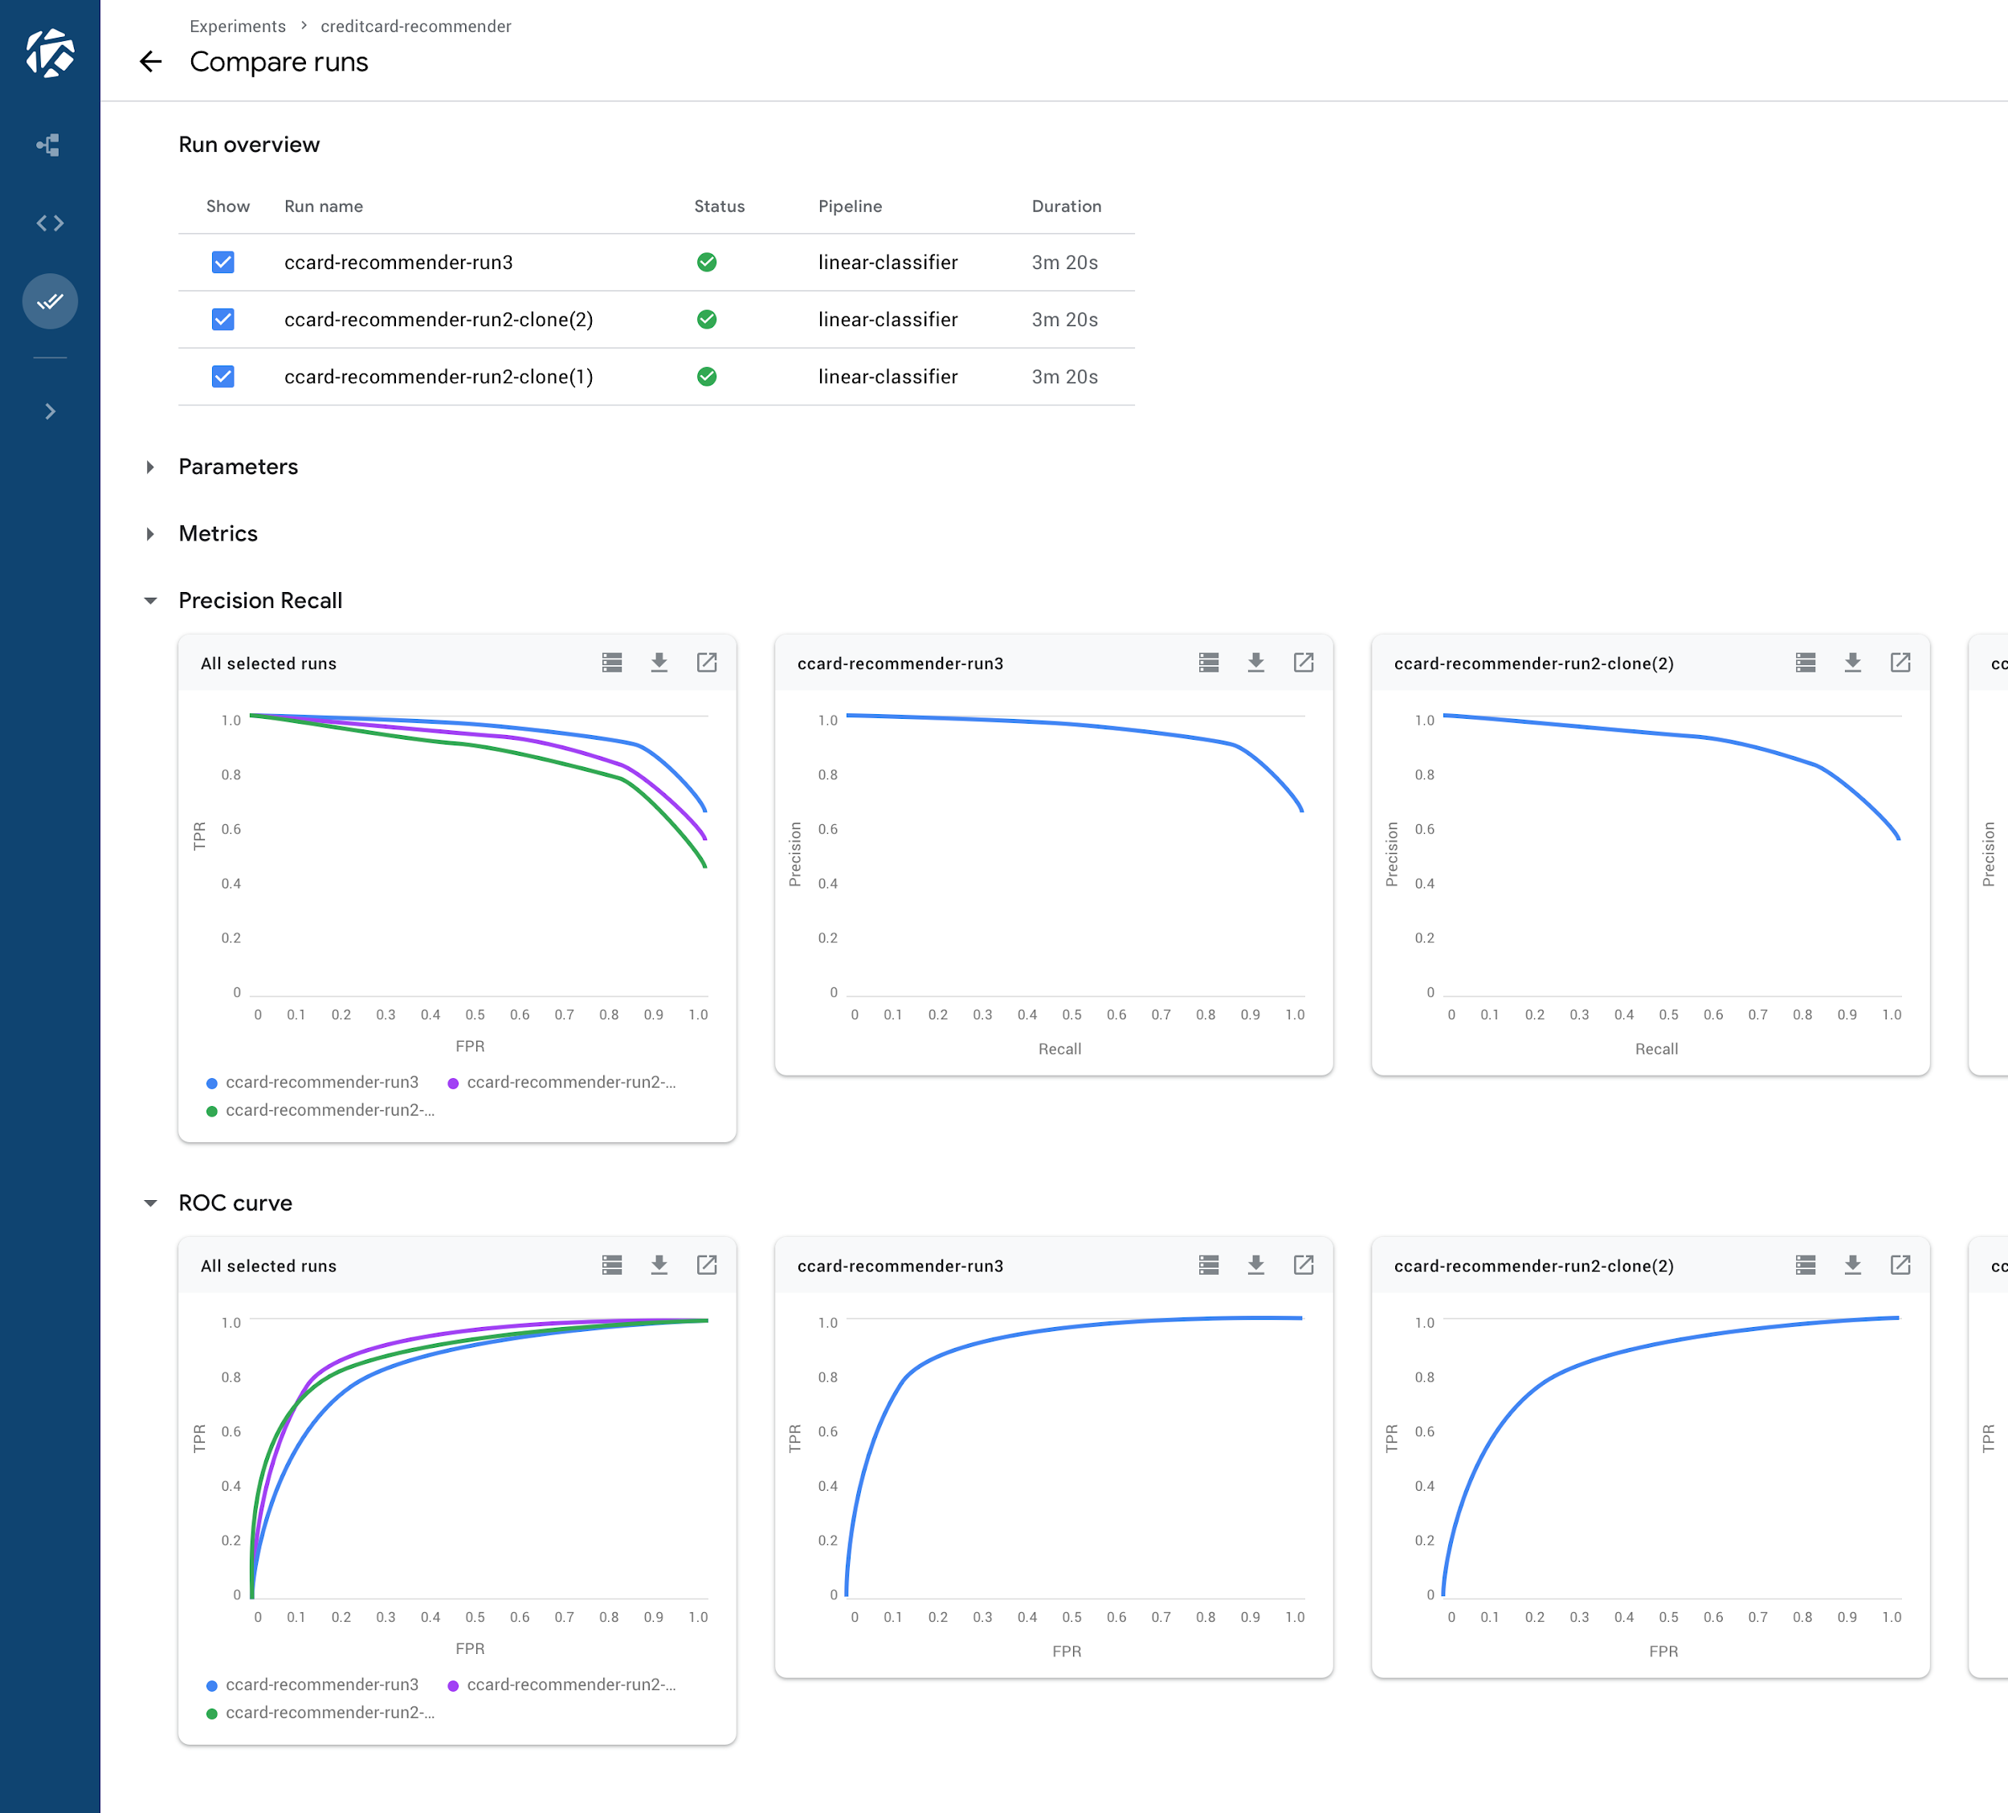
Easy comparison
and analysis
of runs
Label 3
Label 1
Label 2
Notes:
Hone in on the technique or parameter that was different
Quickly identify what worked and what did not work

Slide 22
Agenda
Ways to do ML on GCP
Kubeflow
AI Hub

Slide 23
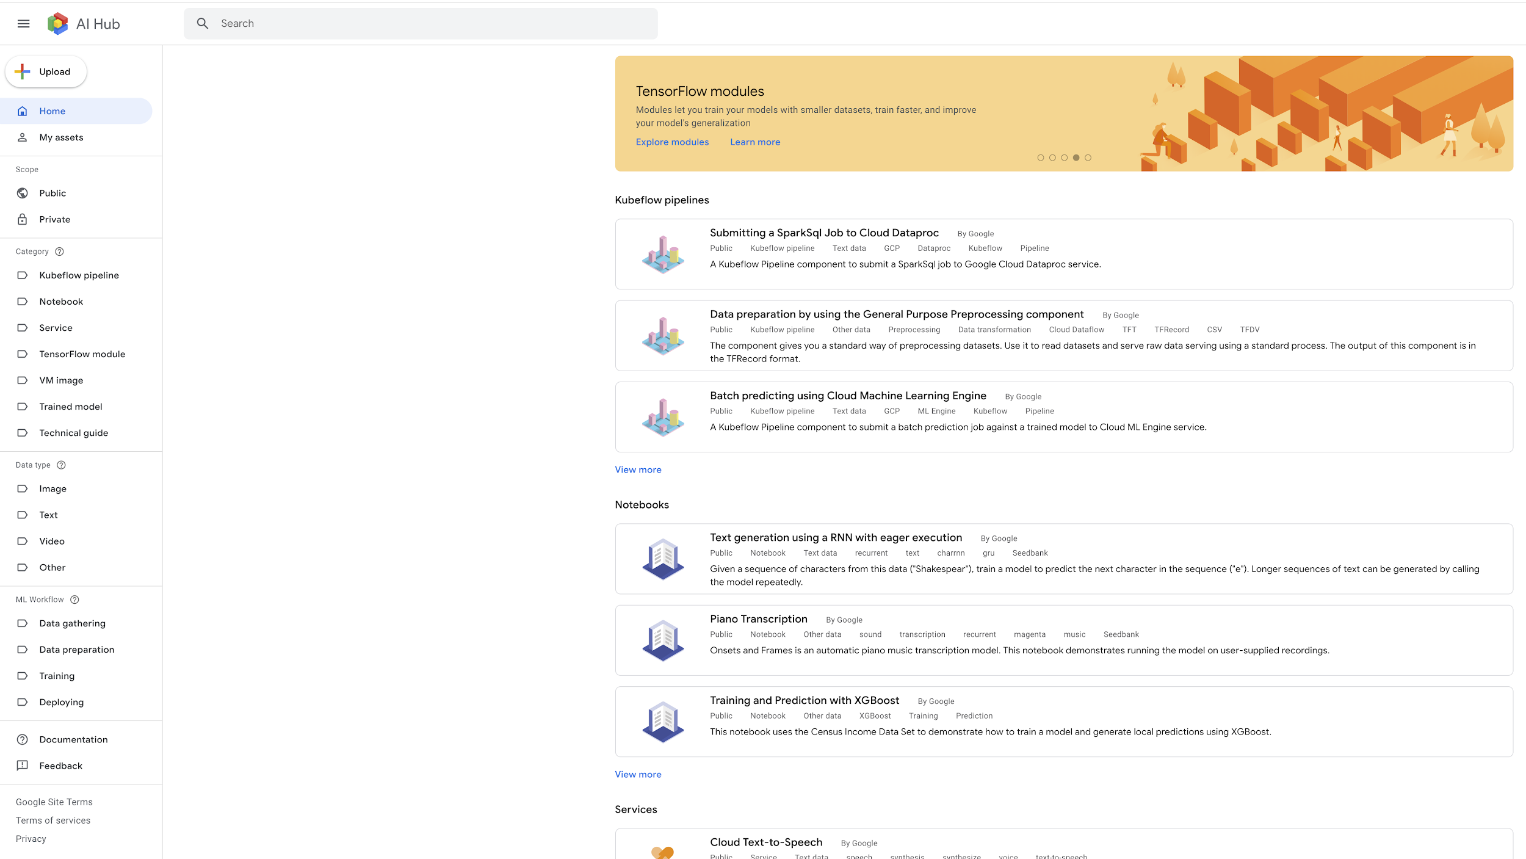
AI Hub is a repository for AI assets
Don’t reinvent the wheel! Find and deploy ML pipelines

Slide 24
AI Hub stores various asset types
Kubeflow pipelines and components
Jupyter notebooks
TensorFlow modules
Trained models
Services
VM images

Slide 25
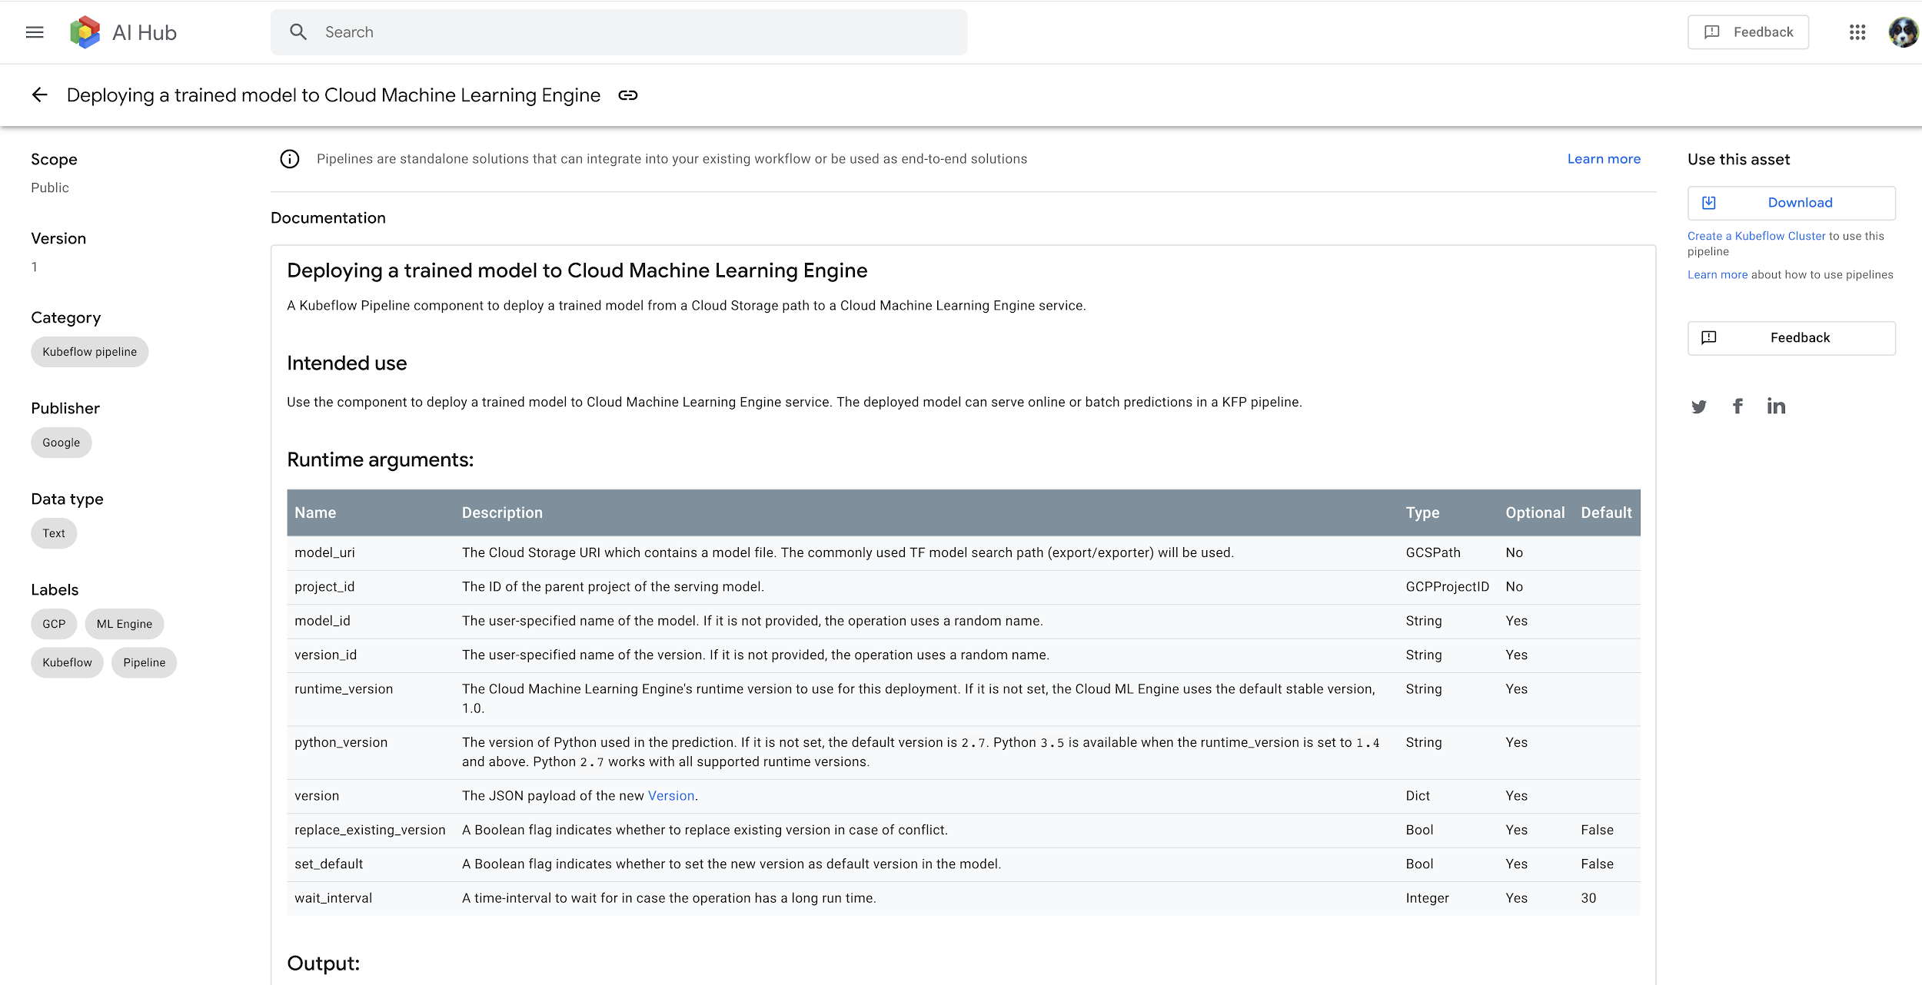
This is what a typical asset looks like...
One-click deployment of ML pipelines via Kubeflow on GCP as platform for AI,
or on premise.

Slide 26
Assets on AI Hub are collected in two scopes: public assets and restricted assets
Public scope are available to all AI Hub users
Restricted scope contains AI components that you have uploaded and assets that have been shared with you

Slide 27
Lab
Running AI models on Kubeflow
Objectives
Set up Kubeflow on a Kubernetes Engine cluster
Package a TensorFlow program in a container and upload it to Google Container Registry
Submit a tf-train job and save the resulting model to Google Cloud Storage
Serve and interact with a trained model
Notes:
Running AI models on Kubeflow
https://gcpstaging.qwiklabs.com/labs/25374/edit

Slide 28
Module Summary
Use ML on GCP using either
AI Platform (your model, your data)
AutoML (our models, your data)
Perception API (our models, our data)
Use Kubeflow to deploy end-to-end ML pipelines
Don’t reinvent the wheel for your ML pipeline! Leverage pipelines on AI Hub

